Slide 1

Regularization Techniques
Improving OLS and Logistic Regressions

Slide 2
Overfitting vs. Underfitting
In any sort of predictive modelling where we train our model on one dataset (training data) and test on another (testing set), there is a chance of overfitting or underfitting.
Overfitting occurs when our model does well in our training data (predicts y_train well)but does poorly on test data (does not predict y_test well given x_test).
Underfitting is an even worse problem when the model does not perform well on train not test data.
We can observe overfitting if we include all features in the Banking dataset

Slide 3
Why overfit?
The primary reason is that there are too many variables or the wrong combination of relevant features.
Consequently, the model learns the detail and noise in the training data to the extent that it negatively impacts the performance of the model on new data. This means that the noise or random fluctuations in the training data is picked up and learned as concepts by the model. This is then applied to the test.
Today, we will learn of two shrinkage techniques that help us reduce overfitting of both OLS and Logistic regression models. Specifically, we will learn to either reduce the weights of certain variables or remove them all together.

Slide 4
Forward Step Regression
If we have a set of features {X_{p}} and Y, we can create p number of regression by regressing each feature on Y.
Then we can create a hierarchy of our features by looking at the R² and MSE of each regression. The feature with the smallest MSE is our most informative feature, the second smallest MSE is our second feature and so on.
Once we have an ordered list of features, we will add them one by one to a regression. So, first we have y₁ = b₀+ b₃ X₃ then we have y₂ = b₀ + b₃ X₃+ b₅ X₅
We keep adding features until our MSE does not reduce any further.
The features that do not reduce our MSE left out.

Slide 5

What’s wrong with Forward Step Regression?
Original Regression = {B₁,B₂,B₃,B₄,B₅} and final regression {0,B₂,B₃,0,B₅}.
While this sounds like a fair approach, it is very computationally inefficient especially in high dimensional datasets.
Another way to achieve the same result is to penalize the coefficients so that the features have the smallest weight (B). We achieve this by implementing a Ridge regression (L2 regularizatio
In our simple OLS model we have,
Notes:
So we want values of beta that minimize this RSS yes?

Slide 6

Ridge Regression
Ridge regression is very similar to OLS, except that the coefficients are estimated by minimizing a slightly different quantity. In particular, the ridge regression coefficient estimates βˆ are the values that minimize.
The second term, is called a shrinkage penalty, is small when β1, . . . , β_{p} are close to zero, and so it has the effect of shrinking the estimates of β_{j} towards zero

Slide 7
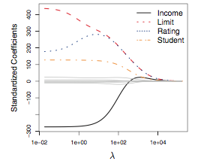
Ridge Regression Continued
When λ = 0, the penalty term has no effect, and ridge regression will produce the least squares estimates. However, as λ → ∞, the impact of the shrinkage penalty grows, and the ridge regression coefficient estimates will approach zero.

Slide 8
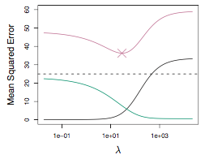
Why Does Ridge Regression Improve Over OLS?
Ridge regression advantage over least squares is rooted in the bias-variance trade-off. As λ increases, the flexibility of the ridge regression fit decreases, leading to decreased variance but increased bias.

Slide 9
Why Does Ridge Regression Improve Over OLS?
At the least squares coefficient estimates, which correspond to ridge regression with λ = 0, the variance is high but there is no bias.
as λ increases, the shrinkage of the ridge coefficient estimates leads to a substantial reduction in the variance of the predictions, at the expense of a slight increase in bias. Recall that the test mean squared error (MSE), plot- ted in purple, is a function of the variance plus the squared bias.

